Slide 1
Root Cause Analysis 101
An overview of Root Cause Analysis and developing Corrective Action Plans

Slide 2
Setting Expectations with an example

Slide 3
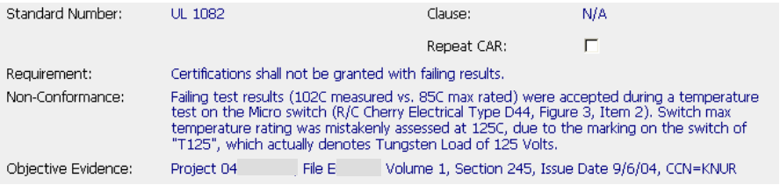
What are the expectations?

Slide 4
What was done with the defective project? – Resolve the evidence
How widespread is the problem? – Scope of the problem
Are there any other projects with the same problem? – Exposure
Why did this happen? – Root Cause Analysis
5. How did this happen? – Detection
6. What can be done to stop this problem immediately? – Containment
7. What actions will be taken so this will not happen again? – Prevention
8. How will you know the solutions were successful? – Verification
How will you know it will not happen again? – Controls

Slide 5
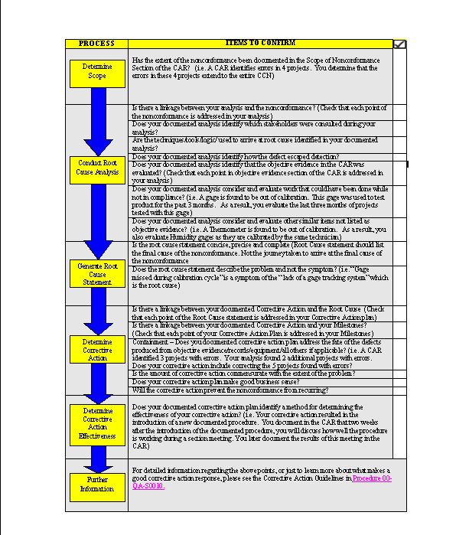
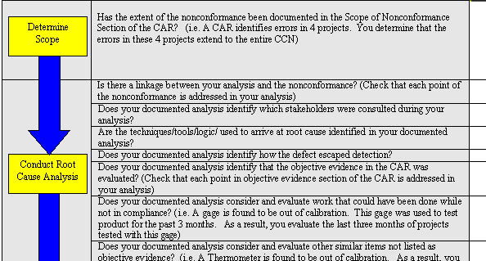
Job Aid –
Checklist for CAR Administrators and Owners
This Job Aid was developed to be used as a tool to help the CAR Owner and CAR Administrator ensure that all elements of the root cause analysis and corrective action plan are included in the CAR responses.
*Job Aid Checklist Items: Are identified in this presentation by this box.

Slide 6
Key Elements of appropriate Root Cause
INPUTS: Nonconformance and Objective Evidence
ACTIVITY: Analysis
  Identification of the stakeholders consulted
  Logical journey (and linkage) from nonconformance to the root cause statement
  Analysis of how defect escaped detection
  How scope of the nonconformance was determined including records evaluated
  Analysis of disposition of records and other nonconformances
OUTPUTS: Scope, Root Cause Statement, Corrective Action Plan
  Scope of the Nonconformance
    Describes full scope and impact of the nonconformance
    Includes records affected, geography
  Root Cause Statement
    Concise, precise, complete
    Not a restatement of symptoms
  Corrective Action Plan

Slide 7
Key Elements of appropriate Root Cause
INPUTS: Nonconformance and Objective Evidence
ACTIVITY: Analysis
  Identification of the stakeholders consulted
  Logical journey (and linkage) from nonconformance to the root cause statement
  Analysis of how defect escaped detection
  How scope of the nonconformance was determined including records evaluated
  Analysis of disposition of records and other nonconformances
OUTPUTS: Scope, Root Cause Statement, Corrective Action Plan
  Scope of the Nonconformance
    Describes full scope and impact of the nonconformance
    Includes records affected, geography
  Root Cause Statement
    Concise, precise, complete
    Not a restatement of symptoms
  Corrective Action Plan
Linkage from Nonconformance to Analysis
Linkage from Analysis to Root Cause Statement and Scope of Nonconformance
*Job Aid Checklist Items: “Is there a linkage between your analysis and the nonconformance?”

Slide 8
Analysis

Slide 9
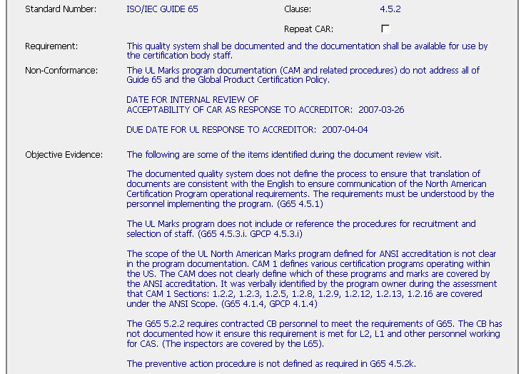
Finding versus Observation:
What problem is being solved?
Finding: Resolves the stated nonconformance, Root Cause Analysis, disposition of records, prevention
Observation: Resolves only the Objective Evidence, no analysis, and no prevention
Fixing Records alone does not prevent recurrence

Slide 10
Involvement of Stakeholders
Every process has stakeholders
  Those who supply inputs into the process
    Example: CAR Owners provide ‘inputs’ to the CAR process when they provide CAR responses
  Those who receive the output of the process
    Example: Internal Quality Auditors receive the ‘output’ of the CAR process to verify effectiveness
  Those who rely on the process and depend on it’s success and effectiveness
    Example: The CPO depends on the CAR process to help maintain their programs
Possible stakeholders for individual CARs
  Reviewers, Project Handlers
  Laboratory
  PDEs
  Staff at other locations or regions

Slide 11
Stakeholders
Don’t analyze the nonconformance in isolation
  Who has the best knowledge of the problem? (this person may be the CAR originator)
  Who has the best knowledge of the process?
  Who provides inputs to the process?
  Who receives outputs from the process?
*Job Aid Checklist Item: “Does your documented analysis identify which stakeholders were consulted during your analysis?”
Notes:
Person(s) having the best knowledge of the problem – may be the CAR originator
Try to find the process owner, if one exists (basic problem we still have at UL is that there are very few defined process owners)
If you are performing the step of the process where the nonconformance occurs, who provides information to you?
After you finish performing the part of the process where the nonconformance occurs, who receives your information?

Slide 12

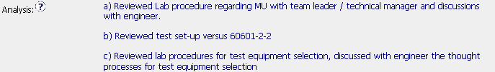
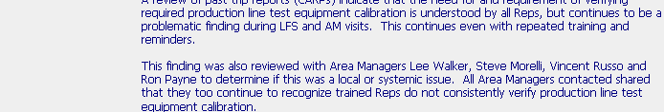
Stakeholders
Examples of interaction with stakeholders

Slide 13
Some Root Cause Analysis Methodologies
Five Whys
  Continue asking “Why?” until the answer is “I don’t know”
Occurrence Cause Mapping
  What went wrong?
Brainstorming
  Technique for gathering lots of ideas from stakeholders
Cause-and-Effect or Fishbone Diagrams
  Visual method to organize ideas and see relationships
Pareto Diagrams
  Tool for analyzing the data that has been collected
*Job Aid Checklist Item: “Are the techniques/tools/logic/ used to arrive at root cause identified in your documented analysis?”
Notes:
Five Whys – simple method, easy to understand
Occurrence Cause Mapping – stepping through exactly what went wrong, almost like a flow chart of how the nonconformance happened
Brainstorming – Generates lots of ideas; generally need to use another tool (Cause-and-Effect, Pareto, etc.) to further refine and organize
Cause-and-Effect Diagram – good tool for organizing ideas in order to group and relate
Pareto Diagrams – another way to refine and organize facts or data

Slide 14
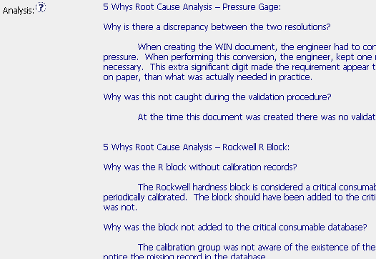
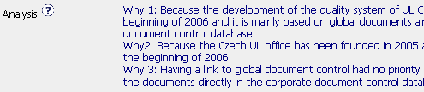
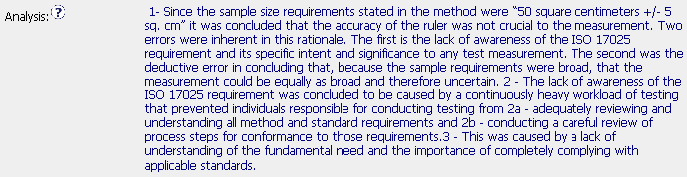
Root Cause Analysis Methodologies
Variations of the classic “5 Whys”
Occurrence Cause Mapping

Slide 15
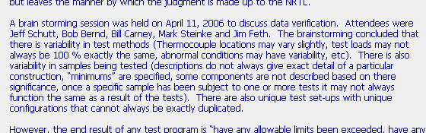
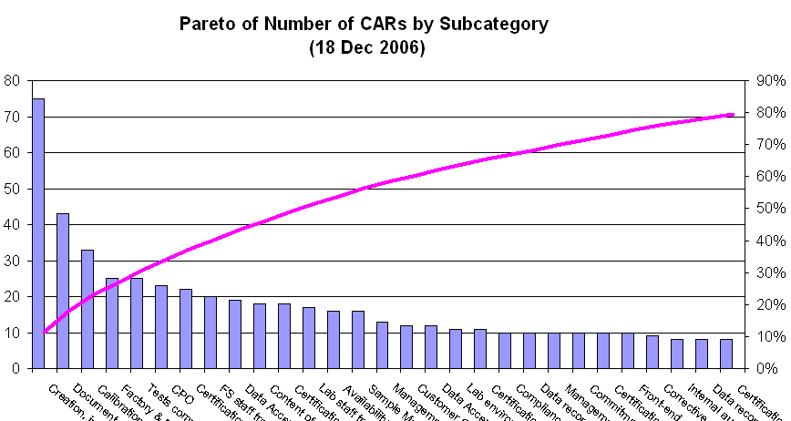
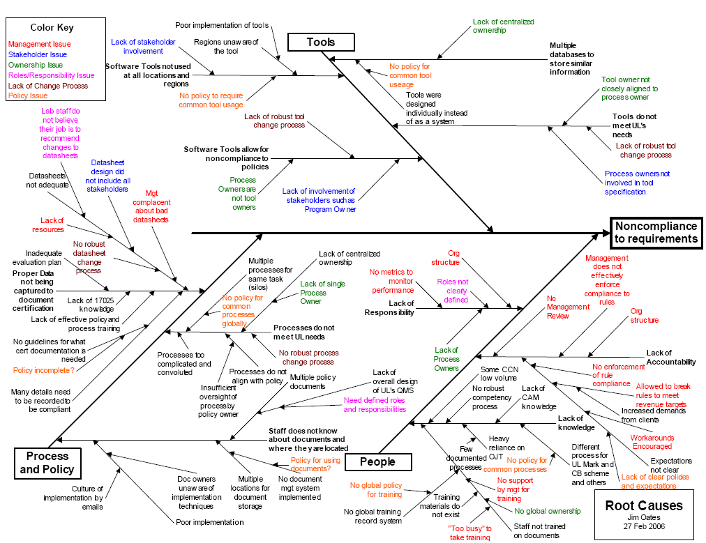
Root Cause Analysis Methodologies
Brainstorming Session
Pareto Analysis
Cause-and-Effect Diagram

Slide 16

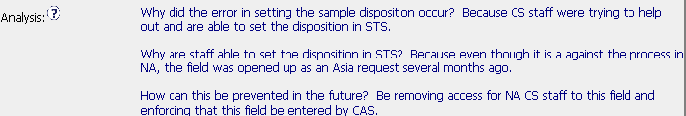
How did the defect escape?
Reviewer and handler were misled by similarity of the data
Item was being entered outside of the process by incorrect personnel
*Job Aid Checklist Item: “Does your documented analysis identify how the defect escaped detection?”

Slide 17
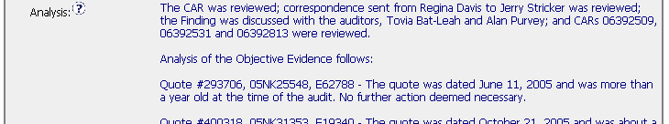
Disposition of Records
Root cause investigation includes an analysis of the records cited in the Objective Evidence of the nonconformance
*Job Aid Checklist Item: “Does your documented analysis identify that the objective evidence in the CAR was evaluated?”

Slide 18

Disposition of Records
Analysis must consider other records that may also be defective but not identified in the Objective Evidence
a
b
c
*Job Aid Checklist Item: “Does your documented analysis consider and evaluate work that could have been done while not in compliance?”

Slide 19
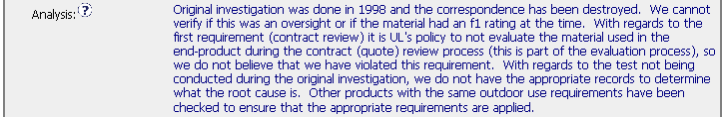
Disposition of Records
Analysis should also consider other areas and records that may have the problem but were not included in the Objective Evidence
1
2
*Job Aid Checklist Item: “Does your documented analysis consider and evaluate other similar items not listed as objective evidence?”

Slide 20
Result of the Analysis –
Scope of the Nonconformance

Slide 21
Elements of the Scope of Nonconformance
Defines the Functional Groups affected
Describes the records affected
Provides indication of the locations affected
Scope is determined during the analysis because the CAR’s Objective Evidence does not describe the entire scope of the problem

Slide 22
Importance of defining the
Scope of the Nonconformance
Shows the extent of the problem
Need to know the scope to properly identify the areas where the corrective actions need to be applied.
This is an area for improvement
*Job Aid Checklist Item: “Has the extent of the nonconformance been documented in the Scope of Nonconformance Section of the CAR?”

Slide 23


Review these Scopes of Nonconformances
1.
2.
1.
1.
1.
3.
4.
5.
6.
7.
The Scope of the Nonconformance should describe. . .
    Who was affected: Groups, individuals affected
    Where: Locations, regions, sectors with the problem
    What: Records are affected
    How widespread

Slide 24
Review these Scopes of Nonconformances
1.
What reviews? Where?
2.
1.
1.
1.
3.
4.
5.
6.
7.
The Scope of the Nonconformance should describe. . .
    Who was affected: Groups, individuals affected
    Where: Locations, regions, sectors with the problem
    What: Records are affected
    How widespread

Slide 25
Review these Scopes of Nonconformances
1.
What reviews? Where?
2.
1.
Restates the requirement, not exposure.
1.
1.
3.
4.
5.
6.
7.
The Scope of the Nonconformance should describe. . .
    Who was affected: Groups, individuals affected
    Where: Locations, regions, sectors with the problem
    What: Records are affected
    How widespread

Slide 26
Review these Scopes of Nonconformances
1.
What reviews? Where?
2.
1.
Restates the requirement, not exposure.
1.
1.
3.
How “common”? Locations?
4.
5.
6.
7.
The Scope of the Nonconformance should describe. . .
    Who was affected: Groups, individuals affected
    Where: Locations, regions, sectors with the problem
    What: Records are affected
    How widespread

Slide 27
Review these Scopes of Nonconformances
1.
What reviews? Where?
2.
1.
Restates the requirement, not exposure.
1.
1.
3.
How “common”? Locations?
4.
This is a requirement. How widespread is the problem?
5.
6.
7.
The Scope of the Nonconformance should describe. . .
    Who was affected: Groups, individuals affected
    Where: Locations, regions, sectors with the problem
    What: Records are affected
    How widespread

Slide 28
Review these Scopes of Nonconformances
1.
What reviews? Where?
2.
1.
Restates the requirement, not exposure.
1.
1.
3.
How “common”? Locations?
4.
This is a requirement. How widespread is the problem?
5.
What locations? How widespread?
6.
7.
The Scope of the Nonconformance should describe. . .
    Who was affected: Groups, individuals affected
    Where: Locations, regions, sectors with the problem
    What: Records are affected
    How widespread

Slide 29
Review these Scopes of Nonconformances
1.
What reviews? Where?
2.
1.
Restates the requirement, not exposure.
1.
1.
3.
How “common”? Locations?
4.
This is a requirement. How widespread is the problem?
5.
What locations? How widespread?
6.
Better scope.
7.
The Scope of the Nonconformance should describe. . .
    Who was affected: Groups, individuals affected
    Where: Locations, regions, sectors with the problem
    What: Records are affected
    How widespread

Slide 30
Review these Scopes of Nonconformances
1.
What reviews? Where?
2.
1.
Restates the requirement, not exposure.
1.
1.
3.
How “common”? Locations?
4.
This is a requirement. How widespread is the problem?
5.
What locations? How widespread?
6.
Better scope.
7.
Better scope.
The Scope of the Nonconformance should describe. . .
    Who was affected: Groups, individuals affected
    Where: Locations, regions, sectors with the problem
    What: Records are affected
    How widespread

Slide 31
Result of the Analysis –
Root Cause Statement

Slide 32
Root Cause Statement Summary
Concise, lists the true root cause and does not restate the symptoms
Linkage - There must be a logical connection from the requirement to the nonconformance to the root cause statement
Be wary of “lack of knowledge”, “human error”, “item overlooked” and “inadequate training” as root causes
Every problem needs a root cause statement
*Job Aid Checklist Items: “Is the root cause statement concise, precise and complete?
Does the root cause statement describe the problem and not the symptom?”
Notes:
Usually, the root cause should be only one or two sentences. If you start writing more than that, you probably are restating symptoms or analysis, and have not truly identified the root cause.
You must make sure that you have addressed the actual problem that was observed; linkage will help to show this
All of these “excuses” require asking another “Why?”
If there was a problem, there must be a root cause
Frustration, aggravation, and embarrassment

Slide 33


Examples - Root Causes
A
B
C

Slide 34
Examples - Root Causes
“Potential” is not a root cause.
A
B
C
Notes:
A – If you use words like “potential” or other such imprecise words, you have not identified the true root cause
B – Root Cause is really little more than a restatement of the nonconformance; why were there not training requests?
C - Acceptable

Slide 35
Examples - Root Causes
“Potential” is not a root cause.
A
B
A restatement of nonconformance is not a root cause.
C
Notes:
A – If you use words like “potential” or other such imprecise words, you have not identified the true root cause
B – Root Cause is really little more than a restatement of the nonconformance; why were there not training requests?
C - Acceptable

Slide 36
Examples - Root Causes
“Potential” is not a root cause.
A
B
A restatement of nonconformance is not a root cause.
C
Better root cause
Notes:
A – If you use words like “potential” or other such imprecise words, you have not identified the true root cause
B – Root Cause is really little more than a restatement of the nonconformance; why were there not training requests?
C - Acceptable

Slide 37

Group Discussion –
Would you accept this root cause?

Slide 38
Group Discussion –
Would you accept this root cause?
Where is the proof? Is it in the Analysis?

Slide 39

Group Discussion –
Would you accept this root cause?

Slide 40
Group Discussion –
Would you accept this root cause?
This says “They didn’t know because they didn’t know” – NOT a root cause!

Slide 41
Group Discussion –
Would you accept this root cause?

Slide 42
Group Discussion –
Would you accept this root cause?
“Possible error” – Needs more work to complete the analysis.

Slide 43
Group Discussion –
Would you accept this root cause?

Slide 44
Group Discussion –
Would you accept this root cause?
How do we know? – More analysis needed to confirm. What if the reason for this nonconformance is still occurring today?

Slide 45

Root Cause Warning Bells
“Lack of resources”
“Inadequate training” or “Lack of training”
“Did not understand, was not aware”
“Potential” or “Possible” – indication that investigation was not completed
“This is not a finding”
“Isolated incident”
“Person has left the company” so problem no longer exists
“Human Error”

Slide 46
Root Cause Warning Bells
“Lack of resources” ← Solution needs to be: Get more resources!
“Inadequate training” or “Lack of training” ← Why?
“Did not understand, was not aware” ← Why?
“Potential” or “Possible” – indication that investigation was not completed ←Finish
“This is not a finding” ← Why?
“Isolated incident” ← How do you know?
“Person has left the company” so problem no longer exists ← Really?
“Human Error” ← Why? Can error-proofing eliminate?

Slide 47
Observation Response Requirements
A. Observation that documents a record not in compliance
  CAR response is required – the corrective action plan and associated milestone(s) must be completed, “not applicable” (or similar) in all other required fields.
  Objective evidence that the record has been addressed is required as objective evidence before the CAR can be closed.
B. Suggestions for Improvement
  Noted as a suggestion in the the nonconformance section
  The Owner decides whether to respond
  Document that decision in the CAR’s Root Cause Analysis field
  Observations can be forced closed by the CAR Administrator after an acceptable implementation has been received.

Slide 48
Root Cause Summary
Analysis
  Consult with stakeholders
  Document the thought-process used to determine the cause
  Describe how defect escaped detection
Results of Analysis
  Scope of the nonconformance – Is it isolated or widespread? (this should include a description of the records evaluated to determine scope)
  Root Cause Statement – Clear, concise statement of the cause of the nonconformance.
Notes:
Now that a nonconformance has been properly documented, it is time for the owner to start analyzing the problem in order to determine the root cause and to develop corrective action.
We’ll go through these aspects in more detail in the following slides.

Slide 49
Corrective Action Plans

Slide 50
Job Aid –
Checklist for CAR Administrators and Owners
This Job Aid was developed to be used as a tool to help the CAR Owner and CAR Administrator ensure that all elements of the root cause analysis and corrective action plan are included in the CAR responses.
*Job Aid Checklist Items: Are identified in this presentation by this box.

Slide 51
Setting expectations – Corrective Action Plans
What was done with the defective project? – Resolve the evidence
How widespread is the problem? – Scope of the problem
Are there any other projects with the same problem? – Exposure
Why did this happen? – Root Cause Analysis
5. How did this happen? – Detection
6. What can be done to stop this problem immediately? – Containment
7. What actions will be taken so this will not happen again? – Prevention
8. How will you know the solutions were successful? – Verification
How will you know it will not happen again? – Controls

Slide 52
Corrective Action Plans –
Resolving Past Defects
What was done with the defective project? – Resolve the evidence
How widespread is the problem? – Scope of the problem
Are there any other projects with the same problem? – Exposure
Why did this happen? – Root Cause Analysis
5. How did this happen? – Detection
6. What can be done to stop this problem immediately? – Containment
7. What actions will be taken so this will not happen again? – Prevention
8. How will you know the solutions were successful? – Verification
How will you know it will not happen again? – Controls
‘Cleaning up the mess’ does not prevent recurrence

Slide 53
Corrective Action Plans –
Containing Defects
What was done with the defective project? – Resolve the evidence
How widespread is the problem? – Scope of the problem
Are there any other projects with the same problem? – Exposure
Why did this happen? – Root Cause Analysis
5. How did this happen? – Detection
6. What can be done to stop this problem immediately? – Containment
7. What actions will be taken so this will not happen again? – Prevention
8. How will you know the solutions were successful? – Verification
How will you know it will not happen again? – Controls
A recent evaluation showed that 40% of accreditor-generated CARs listed no containment activities!

Slide 54
Corrective Action Plans –
Prevention
What was done with the defective project? – Resolve the evidence
How widespread is the problem? – Scope of the problem
Are there any other projects with the same problem? – Exposure
Why did this happen? – Root Cause Analysis
5. How did this happen? – Detection
6. What can be done to stop this problem immediately? – Containment
7. What actions will be taken so this will not happen again? – Prevention
8. How will you know the solutions were successful? – Verification
How will you know it will not happen again? – Controls
Preventive actions that cover:
  The scope of the problem
  Means to determine success
  Controls to prevent recurrence

Slide 55
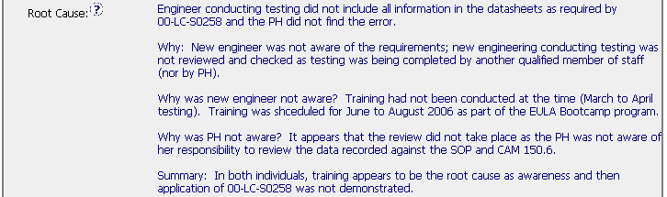

Linkage – Root Cause to Corrective Actions
All elements of the Root Cause should be addressed by the plan
*Job Aid Checklist Item: “Is there a linkage between your documented Corrective Action and the Root Cause?”

Slide 56
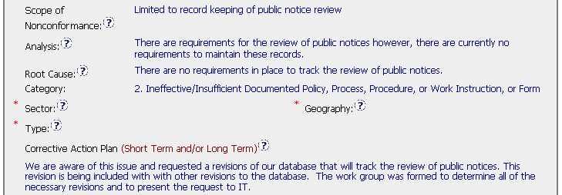
Corrective Action Plans
Does the plan cover the scope of the nonconformance?
Global problems require global solutions, local problems require local solutions.
*Job Aid Checklist Item: “Is the amount of corrective action commensurate with the extent of the problem?”

Slide 57
Resolving records cited in
Objective Evidence

Slide 58


Resolving records –
Examples of Good Practices
Examples of corrected records
Indicates that past records will not be modified
*Job Aid Checklist Item: “Does your documented corrective action plan address the fate of the defects?”

Slide 59
Containment

Slide 60
Containment
Describes the actions to stop the generation or escape of further defects until the long-term solution is implemented
Possible Containment:
None is needed (with explanation, may be described in Analysis)
Description of the specific containment activities
    Corrective Action Plan narrative
    Specific Milestone for completion of containment actions

Slide 61

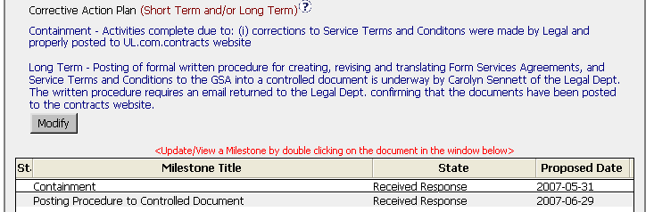
Containment –
Examples of Good Practices
The Corrective Action Plan can describe containment . . .
. . . or the Analysis can show list the reasons why containment is not needed
Note specific containment AND a corresponding milestone

Slide 62
Prevention and Controls

Slide 63
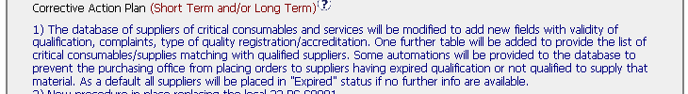
Prevention, controls, effectiveness –
Good Practices
1
2
3
*Job Aid Checklist Item: “Will the corrective action plan prevent the nonconformance from recurring?”
“Does your documented corrective action plan identify a method for determining the effectiveness of your corrective action?”

Slide 64

Prevention –
Some “not as good” Practices
A
B
C
D

Slide 65
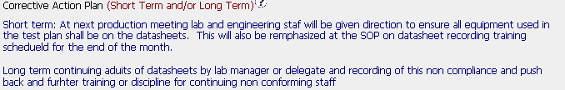
Evaluate these plans
A
B

Slide 66
Evaluate these plans
What was done with the nonconforming records?
A
Containment
Good long-term, details may be in milestones
B
Addresses the objective evidence. . .
. . .but what prevents recurrence?

Slide 67


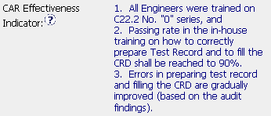




CAR Effectiveness Indicator
CAR Effectiveness Indicator: Describes how the effectiveness of the corrective actions will be measured and judged. Field is located below Milestones.
Watch Out!
Is there something the CAR Owner can do to verify effectiveness before the next internal audit?

Slide 68
Milestones

Slide 69
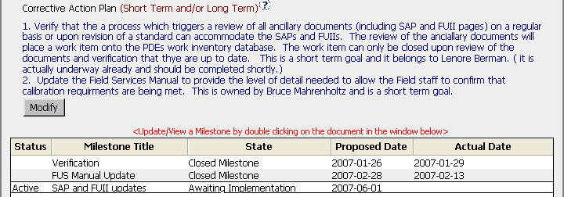
Milestones – Linkage to Corrective Action Plan
Every element of the Corrective Action Plan has corresponding milestone(s)
*Job Aid Checklist Item: “Is there a linkage between your documented Corrective Action and your Milestones?”

Slide 70
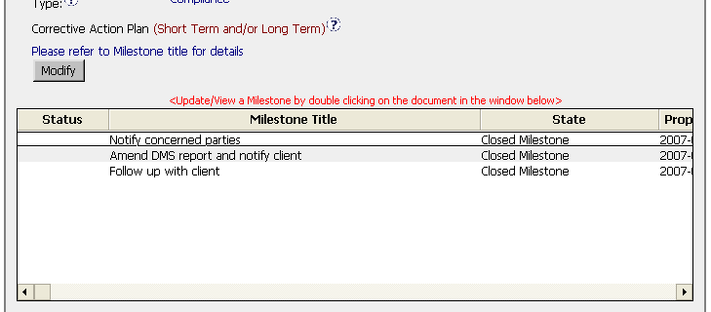
Acceptable Alternative
Provide notation in the Corrective Action Plan to refer to the Milestones for details

Slide 71
Extensions
SHORT CHECKLIST
Has the Owner done work on the CAR?
Is there a legitimate reason for the need for extension?
Are there containment actions in place to contain new defects during the extension period?
Has the CAR been extended before? Is the request for more than 30 days delay? – This requires QEM approval.
Exercise: Acceptable or Unacceptable?
a) Reason - In process of collecting input from DEs. Delay due to workload/involvement in file review.
b) Reason - Other priorities have prevented me from addressing
c) Reason - The LPG has been written and submitted for approval and publication. Once it is published this milestone will be completed.
d) Reason - Still waiting for IT to provide comments on the database. Most recent voicemail update is that they require at least 1 more month

Slide 72

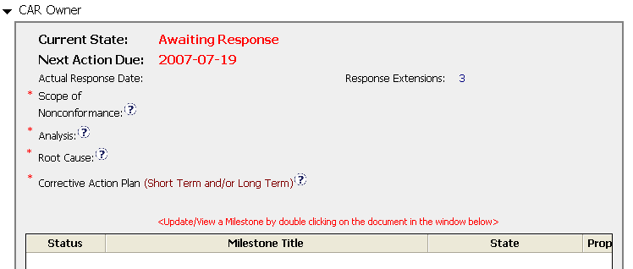

Response Extension –
More than three or 30 days or more
Requests more than 30 days
In both situations: The next Response extension requires Jim Oates’ Approval
Has had 3 Response Extensions

Slide 73
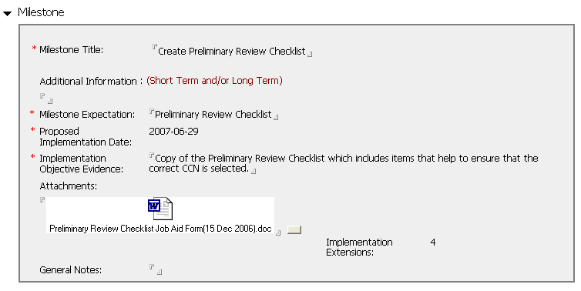



Implementation Extension –
More than three or 30 days or more
Milestone has had 3 Implementation Extensions
In both situations: The next Implementation extension requires Jim Oates’ Approval
Requests more than 30 days

Slide 74
Corrective Action Summary
  Should address any necessary short-term containment actions as well as long-term actions to prevent recurrence
  Should be commensurate with the severity of the nonconformance (sanity check)
    Does the solution appear to make good business sense?
    Is the scope of the plan appropriate for the type and scope of the CAR?
  Consider opportunities to mistake-proof the process.
  Describe controls and means to determine effectiveness (use the CAR Effectiveness Indicator field)
  Linkage!
  Avoid: Solutions that are emails, punitive against individuals, or one-time events

Slide 75
Extensions Recap
Require a valid reason
After third, requires Jim Oates’ approval
Any single extension request for more than 30 days requires Jim Oates’ approval

Slide 76
End of Presentation
Revision History
Revision 1.0 – Updated July 2007
  Complies with 00-QA-S0010 Issue 6.1 and 00-QA-J0029 Issue 1.0.
Source: Modifications of Modules 3 and 4 of CAR Administrator training modules

